Slide 1



UML Notation

Slide 2
Acknowledgement
UML has been around for while, as a result a lot of wonderful material has been created. A lot of the diagrams and information in these slides come from those materials, including but not exclusive to:
UCF slides authored by Yi Luo
Jung Woo Slides
www.uml.org
Prior slides used in CS 100

Slide 3
What is UML?
Unified Modeling Language is an Object-modeling Language
An Object-modeling language is a standardized set of symbols for modeling a system
The model of the system is used to document and communicate the characteristics, relationships and functionality of each component within the system

Slide 4
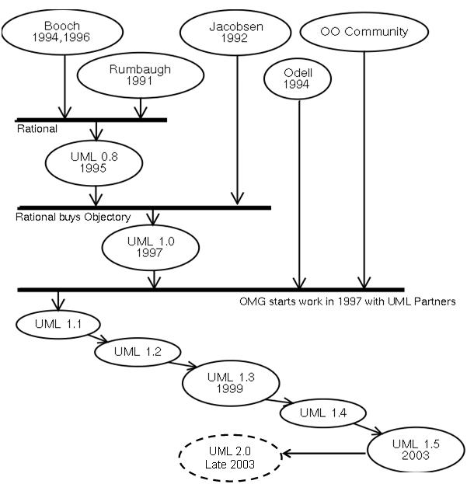
UML’s timeline

Slide 5
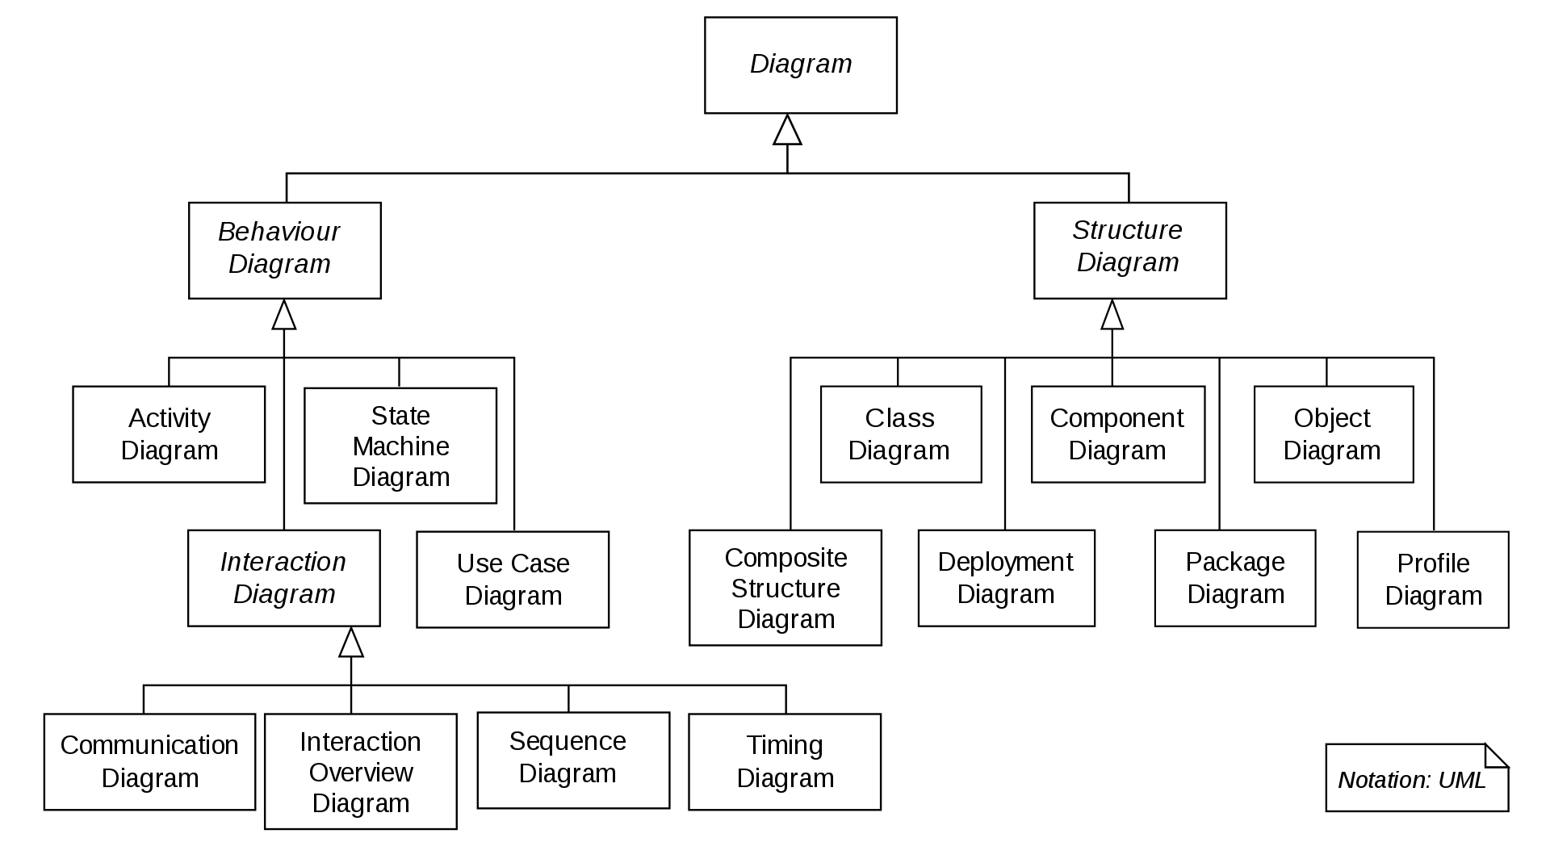
UML Diagrams by Type

Slide 6
Structural Diagrams
They represent the static aspect of the system, that is the components that need to be present for the system to function. The most common structural diagrams are:
Class Diagram: They represent the classes, interfaces, associations and collaborations between classes. They model the object orientation of a system.
Object Diagram: Like Class diagrams but with a focus on instantiations (objects). They model the static view of a system.
Component Diagram: They represent components (can be classes, interfaces, or collaborations) and their relationships/dependencies. Used to model the implementation view of a system.
Deployment Diagram: They represent a set of nodes (e.g. hardware, software) and their relationships. They model the physical entities of a system.

Slide 7
Class Diagrams
UML represents classes as rectangles with the class name on top, then the attributes and finally the operations.
UML includes a modifier to denote the visibility of attributes and operations:
‘+’ is used to denote Public visibility (everyone)
‘#’ is used to denote Protected visibility (derived)
‘-’ is used to denote Private visibility (no one)

Slide 8
Name
Account_Name
- Customer_Name
- Balance
Attributes
+addFunds( )
+withDraw( )
+transfer( )
Operations

Slide 9
Account_Name
- Customer_Name: String
- Balance: int
With signatures
+addFunds( ): Void
+withDraw( ): int
+transfer( ): Void

Slide 10
Class diagrams
Supertype
With UML you can represent many relationships:
Generalization (inheritance, see diagram)
Association (membership)
Aggregation
Composition
Subtype1
Subtype2

Slide 11
Association: Multiplicity and Roles
1
*
University
Person
0..1
*
employer
teacher
Multiplicity
Symbol Meaning
1 One and only one
0..1 Zero or one
M..N From M to N (natural language)
* From zero to any positive integer
0..* From zero to any positive integer
1..* From one to any positive integer
Role
Role
“A given university groups many people; some act as students, others as teachers. A given student belongs to a single university; a given teacher may or may not be working for the university at a particular time.”

Slide 12
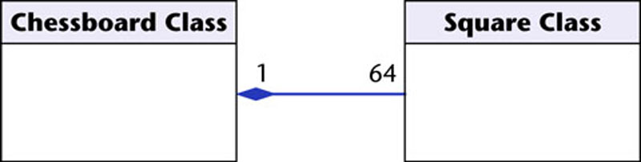
Container Class
Class C
Class W
Composition
AGGREGATION
Class E₁
Class E₂
Class P₁
Class P₂
Containee Classes
Part Classes
Example
Example
Bag
Apples
Milk
[From Dr.David A. Workman]

Slide 13
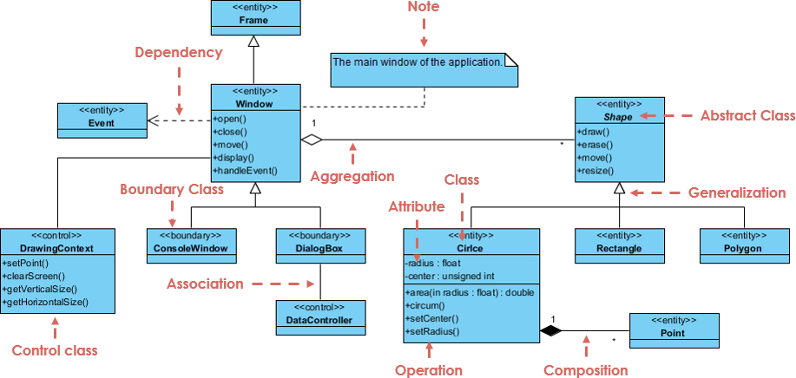
Credit: https://www.visual-paradigm.com/guide/uml-unified-modeling-language/uml-class-diagram-tutorial/

Slide 14
Behavioral Diagrams
Behavioral diagrams model the dynamic aspect of the system, how each element interacts with each other. The most common Behavioral diagrams are:
Use Case Diagram: Represents the use case view of the system including actors and their relationships.
Interaction Diagram: Represents the sequence of interactions within the system
State Machine Diagram: Shows the state of the system and triggers for changing between one state and the other.
Activity Diagram: Represents the control flow within the system by denoting activities and links between activities.

Slide 15
Interaction Diagrams
Caller
Phone
Recipient
Picks up
Sequence Diagram
Dial tone
Dial
Ring notification
Ring
Picks up
Hello

Slide 16
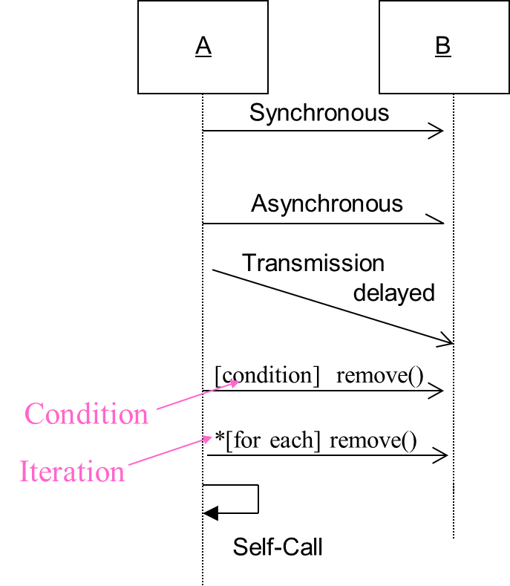
Sequence Diagram: Object interaction
Self-Call: A message that an
Object sends to itself.
Condition: indicates when a message is sent. The message is sent only if the condition is true.

Slide 17
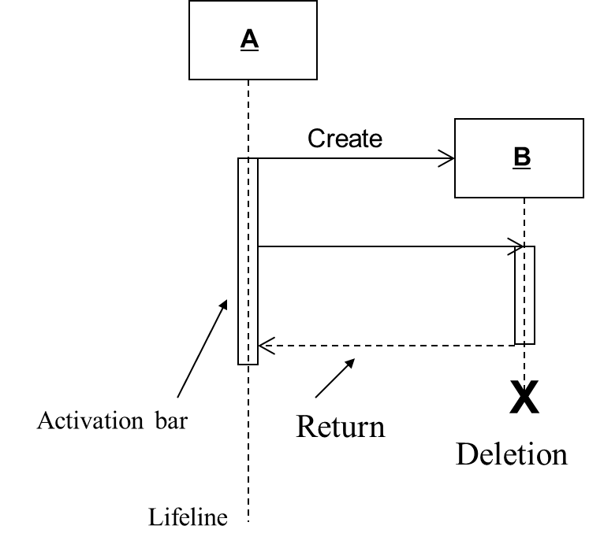
Sequence Diagrams – Object Life Spans
Creation denotes when the object is created
Activation represented by a bar that shows when the object is activated and deactivated.
Deletion marked by X

Slide 18
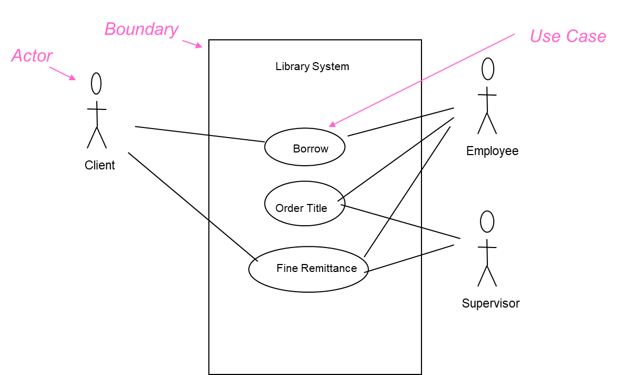
Use Case Diagrams
Shows the interaction between systems/users
Describes a set of scenarios and is commonly used to capture requirements

Slide 19
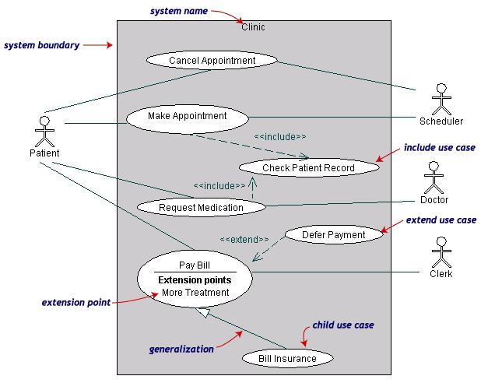
Use-Case Diagrams: Example
Both Make Appointment and Request Medication include Check Patient Record as a subtask (include)
The extension point is written inside the base case Pay bill; the extending class Defer payment adds the behavior of this extension point. (extend)
Pay Bill is a parent use case and Bill Insurance is the child use case. (generalization)
(TogetherSoft, Inc)

Slide 20

With all that being said….
Within Agile, maintaining UML diagrams as part of documentation is not practical. But they are still useful for communicating high level details of a system and understanding design patterns.

Slide 21
UML Activity
Go to Gradescope.com
Find ICE #4 on UML Diagrams
Work in pairs on drawing the class diagram for the provided C++ code

